Slide 1
Science Understanding
Homeostasis
Fluid

Slide 2
Unit 3 – Homeostasis
body fluid concentrations are maintained by balancing water and salts via the skin, digestive system and the kidneys, which involve the actions of antidiuretic hormone (ADH) and aldosterone on the nephron, and the thirst reflex

Slide 3
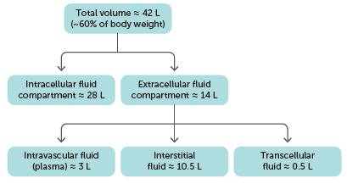
6.1 Regulation of the composition of body fluids
Fluid inside the cells is called intracellular fluid, or cytosol.
Fluid outside the cells is extracellular fluid. Extracellular fluid includes the:
– blood plasma located within the blood vessels, also known as intravascular fluid
– fluid between the cells, known as interstitial fluid, intercellular fluid or tissue fluid
– fluid in specific body regions, known as transcellular fluid, which includes the fluid in the brain and spinal cord, eyes and joints, and surrounding the heart.
Distribution of body fluid in an average male adult

Slide 4
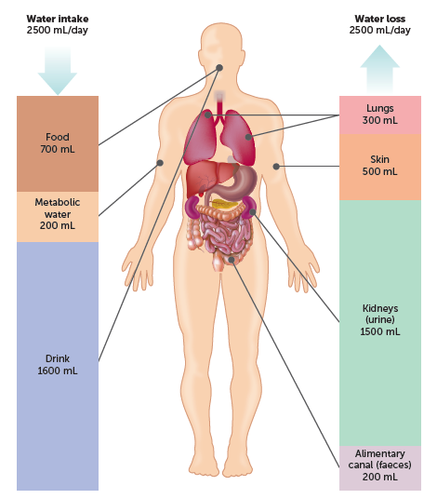
6.1 Regulation of the composition of body fluids
Maintaining fluid balance
Fluid gain must equal fluid loss if the composition of body fluids is to be kept fairly constant. Most body fluid is obtained from water that is either taken in as a liquid or contained in food that is eaten. A small amount is obtained as a by-product of chemical processes occurring within the cells. This water is referred to as metabolic water.
Fluids are lost from the body via the kidneys, through the skin, from the surface of the lungs and from the alimentary canal. Typically, about 2.5 L of fluid are lost each day.

Slide 5
Water in the body
Approximate fluid make-up of a 70 kg person
Intracellular fluid 21 L
Extracellular fluids
  Interstitial (tissue) fluid 13.8 L
  Blood plasma 3.0 L
  Other 0.7 L
17.5 L
TOTAL 38.5 L

Slide 6
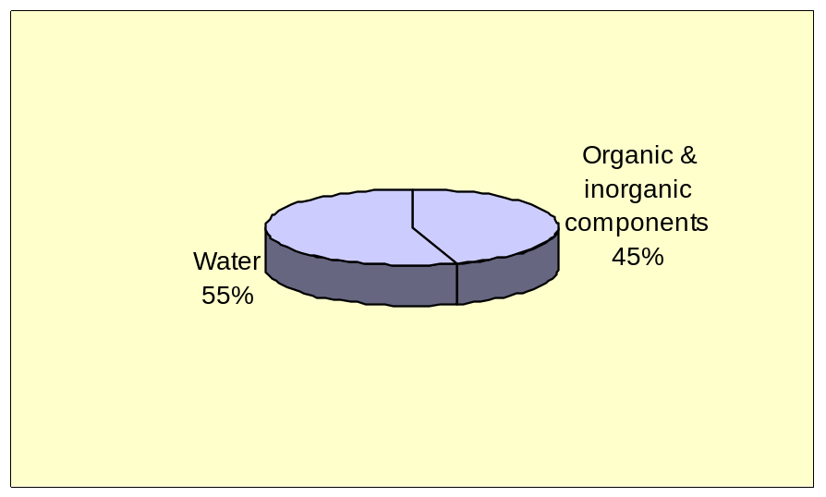
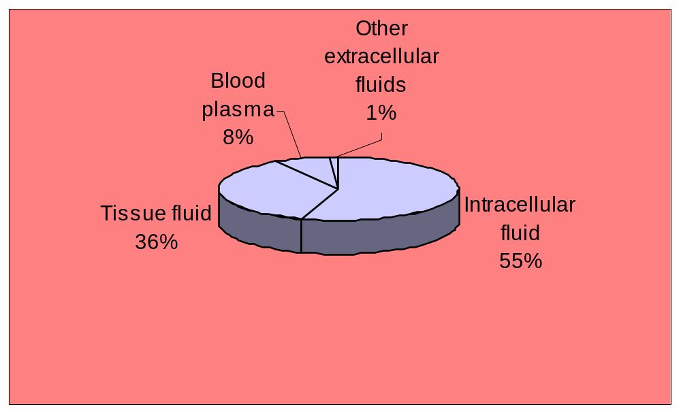
Body fluids

Slide 7
Fluid circulation
Substances enter and leave the bloodstream via the permeable capillaries.
At the arterial end of a capillary there is a mass flow of plasma and nutrients from the bloodstream into the tissue fluid.
This occurs because the blood pressure is greater than the osmotic pressure (working in the opposite direction).

Slide 8
As the blood is forced through the capillary the blood pressure drops.
At the venous end of a capillary there is a mass flow of tissue fluid and wastes from the tissues into the bloodstream.
This occurs because the blood pressure is now less than the osmotic pressure.

Slide 9
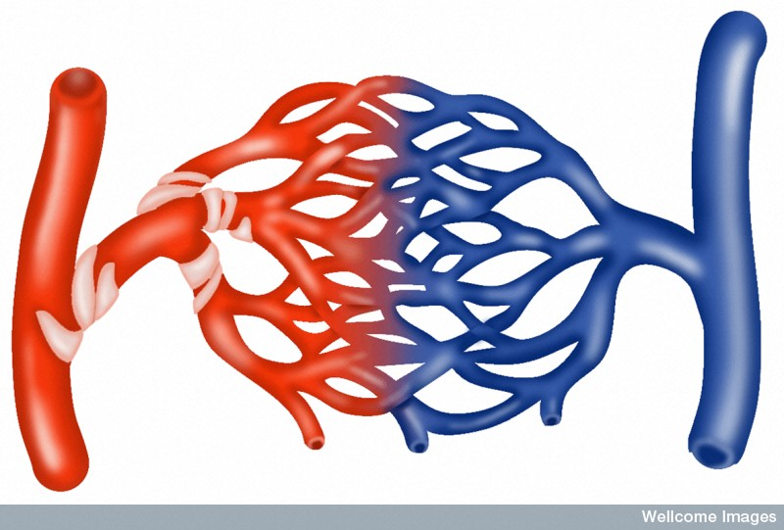
Fluid circulation
Venule
Nutrients
Arteriole
Wastes
Capillary bed
BP
BP
Osmosis
Osmosis
Tissue fluid
Tissue fluid

Slide 10
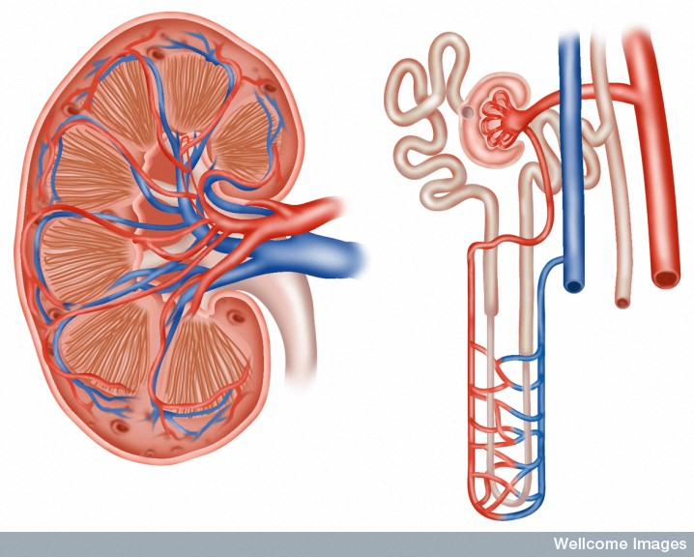
Structure of the kidney
Proximal convolute tubule
Distal convolute tubule
Capsule
Cortex
Renal corpuscle
Medulla
Pyramid
Renal artery
Collecting duct
Renal vein
Loop of Henle
Pelvis of ureter
Peritubular capillaries
Ureter
LS of KIDNEY
A NEPHRON

Slide 11
Kidneys functions
Fluid balance
Salt balance
Removal of wastes (especially urea)
pH balance
Interdependent

Slide 12
Fluid balance
The kidneys play an important role in the homeostatic regulation of body fluids (both the amount and the composition).
If we become dehydrated the kidneys can increase the reabsorption of water from the filtrate, whilst also increasing the secretion of salt.
If our tissue fluids are too dilute the opposite occurs.

Slide 13
Water reabsorption
60-70 % of water reabsorption occurs in the proximal convolute tubule*.
The remaining 30-40 % is selectively reabsorbed in the loop of Henle, distal convolute tubule and collecting duct, depending on our state of dehydration.
*How much water is reabsorbed at both stages depends on our state of dehydration i.e. less water is reabsorbed if our tissue fluid is dilute; more if we are dehydrated.

Slide 14
Urine formation
There are three stages in urine formation:
Filtration (in the renal corpuscle)
Selective reabsorption (mainly in the proximal convolute tubule – some water and salts are reabsorbed in the loop of Henle and the distal convolute tubule)
Tubular secretion (in the proximal convolute tubule and the distal convolute tubule)

Slide 15
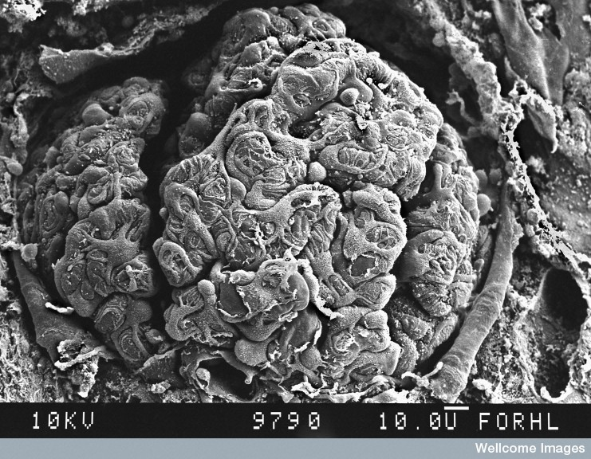
EM of a glomerulus
D Gregory & D Marshall, Wellcome Images

Slide 16
Filtration
Process | Structure | Substance | Active/passive
Filtration | Renal corpuscle | Filtrate
 |  | Water Urea, Glucose, Amino acids, Vitamins, Salts (mainly sodium & chlorine) | Passive (mass flow) Passive

Slide 17
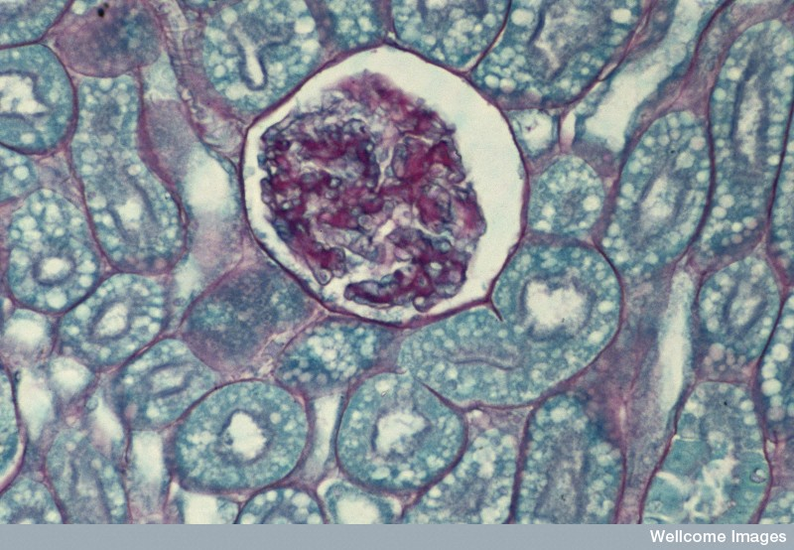
Section showing Bowman's capsule, glomerulus and tubules
Bowman's capsule
Glomerulus
Tubule
Wellcome Photo Library

Slide 18
Selective reabsorption
Process | Structure | Substance | Active/passive
Reabsorption | PCT | Water (60-70%) Salts (60-70%) Glucose (100%) Amino acids (100%) Vitamins (100%) | Passive (osmosis) All active
 | Loop of Henle | Water (25%) Na⁺/Cl⁻ (25%) | Active
 | DCT | Water (5%) Na⁺/Cl⁻ (5%) | Active
 | Collecting duct | Water (5%) | Active

Slide 19
Tubular secretion
Process | Structure | Substance | Active/passive
Tubular secretion | PCT & DCT | H⁺ NH₄⁺ (ammonium) Creatinine Toxins Drugs Neurotransmitters | Active

Slide 20
Selective water reabsorption
The second stage of water reabsorption is important if we become dehydrated.
It can be divided into two phases (though both are interdependent).
The first phase involves the reabsorption of salt under the influence of the hormone aldosterone.
2. The second phase involves the reabsorption of water under the influence of the antidiuretic hormone (ADH).

Slide 21
Reabsorption of salt under the influence of aldosterone
Stimulus
Decreased blood volume
→ reduced blood pressure
Receptor
Baroreceptors in Renal artery

Slide 22
6.1 Regulation of the composition of body fluids
The kidneys and aldosterone
Aldosterone, sometimes called the salt-retaining hormone, is secreted by the adrenal cortex in response to a:
decrease in the concentration of sodium ions in the blood
decrease in blood volume
decrease in blood pressure
increase in the concentration of potassium ions in the blood.
Aldosterone acts on the distal convoluted tubules and collecting ducts to increase the amount of sodium ions reabsorbed into the bloodstream and the amount of potassium secreted in the urine. It achieves this through active transport using a sodium-potassium pump, and therefore has a role in regulating water content of the body.

Slide 23
Transmission
Several chemical messengers ending with release of aldosterone from
the adrenal cortex
Effector
Sodium pumps in DCT and loop of Henle
Response
Sodium reabsorbed increasing ion concentration in interstitial fluid
(creates osmotic gradient)

Slide 24
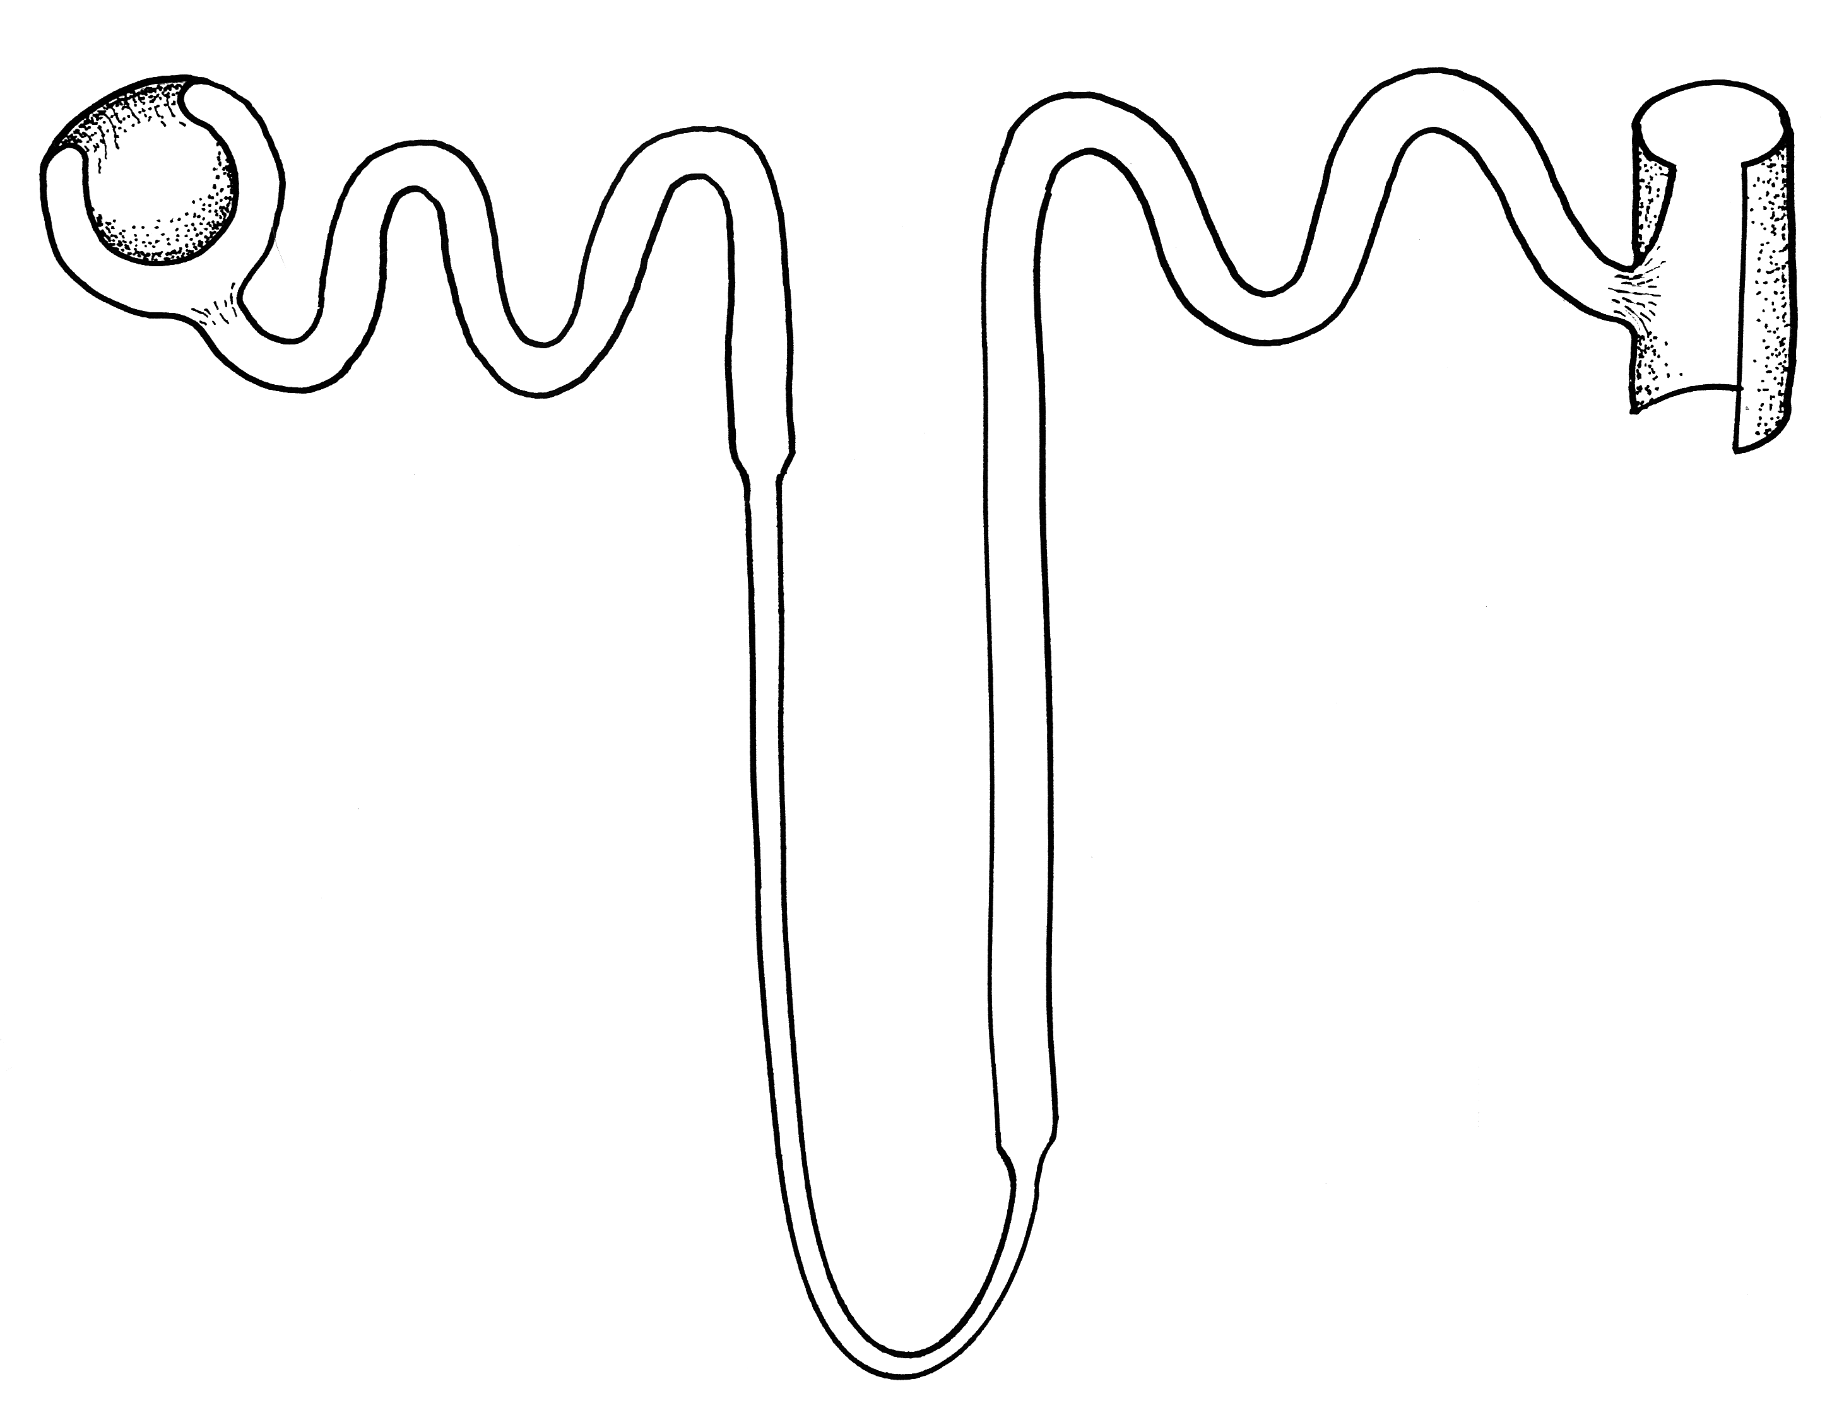
Low
Na+
concentration
In
filtrate
Aldosterone
stimulates sodium pumps
High
Na+
concentration
In
tissue
fluid
Na+
Na+
Na+
Na+

Slide 25
Negative feedback loop
Decreased blood volume
→ reduced blood pressure
Baroreceptors in Renal artery
Stimulus
Receptor
End-product is aldosterone from
adrenal cortex
Creates osmotic gradient
Control
centre
Feedback
Response
Effector
Sodium reabsorbed
Sodium pumps in DCT and loop of Henle

Slide 26
Reabsorption of water under the influence of antidiuretic hormone
Stimulus
Decreased blood volume
→ reduced blood pressure
→ increased osmotic pressure
Receptor
Osmoreceptors in hypothalamus → (activates thirst reflex)

Slide 27
Transmission
nerve signal to posterior pituitary gland
ADH released into bloodstream
Effector
DCT and collecting duct
Response
Increases permeability of above structures
water (approx 10%) reabsorbed

Slide 28
ADH increases
permeability of tubule
Relatively
dilute
filtrate
Water
leaves
the filtrate
by osmosis
Relatively
concentrated
tissue fluid

Slide 29
Negative feedback loop
Decreased blood volume(less water in blood)
→ reduced blood pressure
→ increased osmotic pressure
Osmoreceptors in hypothalamus
Osmotic pressure maintained or reduced (increase water in blood)
Stimulus
Receptor
ADH from posterior pituitary gland
Control
centre
Feedback
Thirst reflex
Drink
Water
reabsorbed
Response
Effector
Increases permeability of DCT and collecting duct
DCT and collecting duct

Slide 30
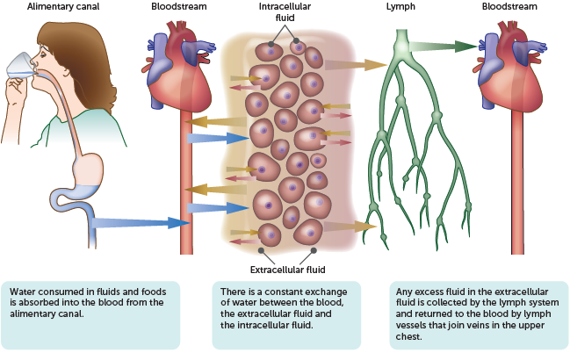
6.1 Regulation of the composition of body fluids
The thirst response
In addition to reducing water loss, the water level of the body can be increased by taking in more fluid. Osmoreceptors stimulate the thirst centre in the hypothalamus, prompting the person to drink water. This fluid is absorbed across the wall of the alimentary canal into the blood, decreasing the osmotic pressure.
Movement of water between the various parts of the body

Slide 31

Study Questions
How does water enter and leave the body?
What are the four most abundant body fluids?
Define the following terms: intracellular fluid, extracellular fluid, interstitial fluid, tissue fluid, solvent, solute, solution
Which type of vessels allow substances to enter and leave blood?
Explain why osmotic pressure of blood plasma is greater than that of surrounding tissue fluid

Slide 32
Study Questions
Why is there a difference in blood pressure gradients between the venous and arterial ends of a capillary bed?
What occurs at the venous and arterial ends of the capillary beds and why does it occur?
What is aldosterone, where is it produced, what stimulates its release, where does it act, and what does it cause?
What hormone regulates water reabsorption in the nephron and collecting duct? Provide the same information for this hormone as for aldosterone

Slide 33
Study Questions
What substances should NEVER EVER be in the urine of a healthy person?
Explain the importance of water reabsorption of from the filtrate and the thirst reflex in fluid homeostasis
Explain why water reabsorption alone cannot reverse the effects of dehydration
Describe the effect of drinking a diuretic, such as coffee, on the osmoregulatory centre in the brain and on the kidneys

